Slide 1
University Community
Report and Response App
By:
Abimbola Adeyemi
Cameron L’Ecuyer
Project Supervisor:
Professor Choi

Slide 2
Contents
Problem Statement
Objective of Project
Introduction
Significant of project
Technologies Used
Overview of the System
Application

Slide 3
Problem Statement
Through observation, and contact with members of the Facilities Division, we have discovered that UMKC lacks an application that allows students, faculty, and staff to report issues to the Facilities Division
This slows the speed at which problem are discovered and corrected

Slide 4
Objectives of Project
Develop a mobile application that would allow students, faculty, and staff to report problems quickly with sufficient detail to the Facilities Division
Develop a web page to allow members of the Facilities Division to view the issues and then create tasks for members of the various facilities teams view, find, and then correct the problems

Slide 5
Introduction
This app was created to provide service to UMKC campus community
Example of some issues are:
Broken toilets/sinks
Burned out light bulbs
Broken door locks
Overflowing trash cans

Slide 6
Significant of project
To contribute to the development of quick response to problems before they require emergency attention
To make a very flexible app that provides prompt response for non emergency issues
To create an avenue where non emergency issues can looked at from a different perspective by the administrators

Slide 7
Technologies Used
Amazon AWS EC2 Web Server Instance running Apache and PHP, and hosting web page
Amazon AWS RDS Server running MySQL
Android Studio to develop Android App
Google Volley for REST services in Android
Angular and JQuery for business logic in the web page
Bootstrap, CSS, and HTML for web page UI

Slide 8
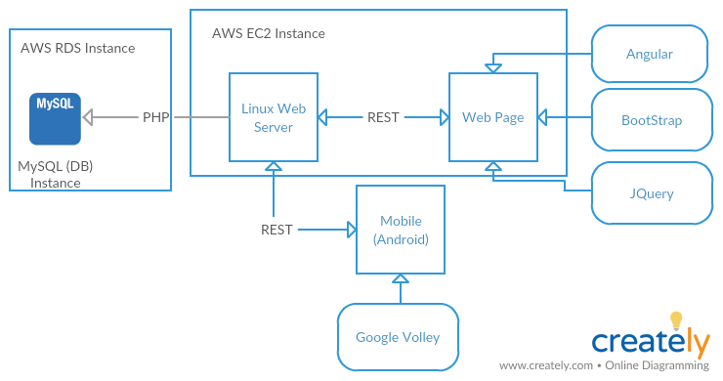
Overview of the System

Slide 9
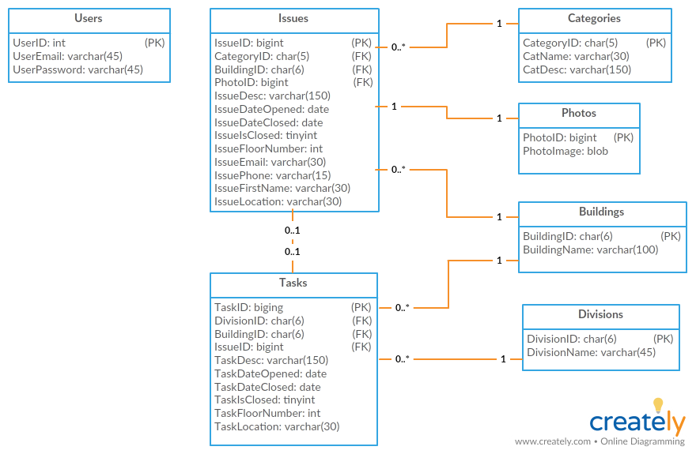
Overview of the System

Slide 10
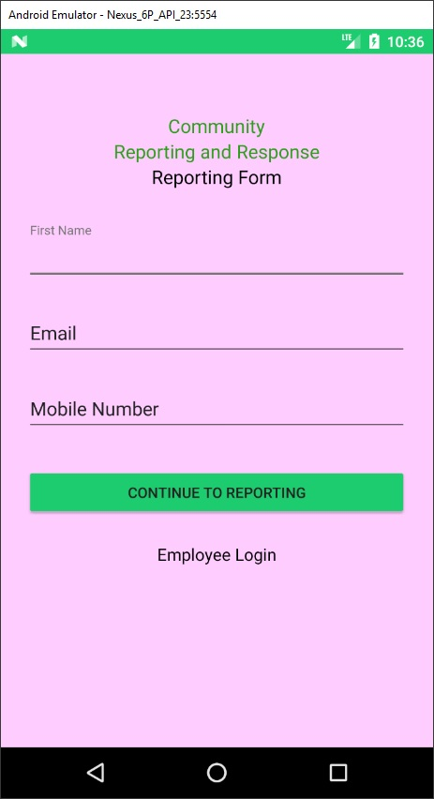
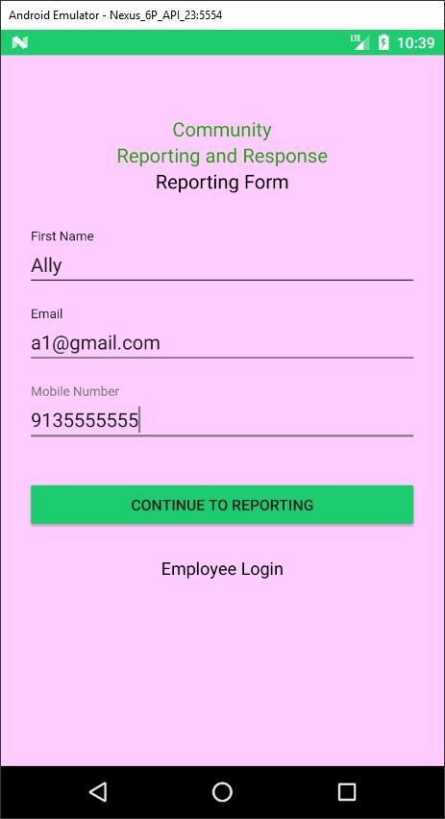
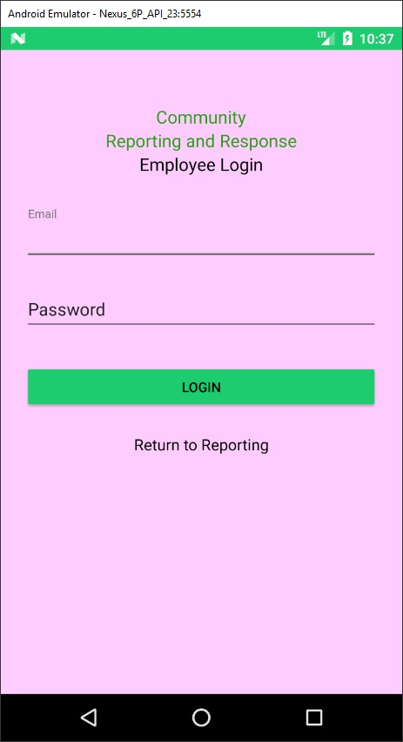
Application

Slide 11
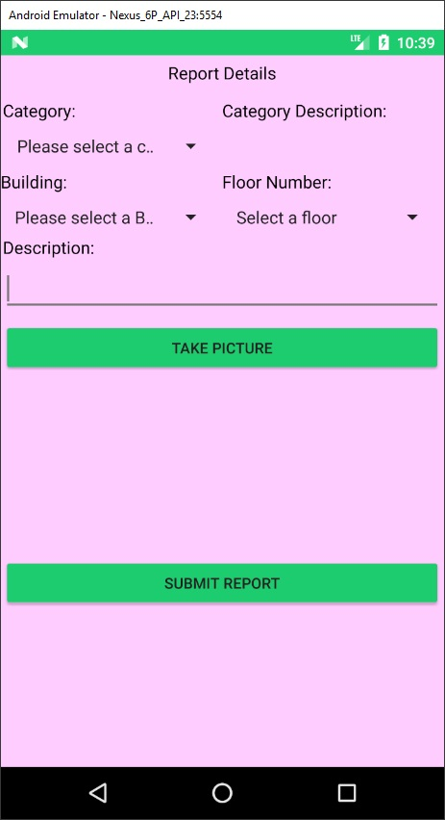
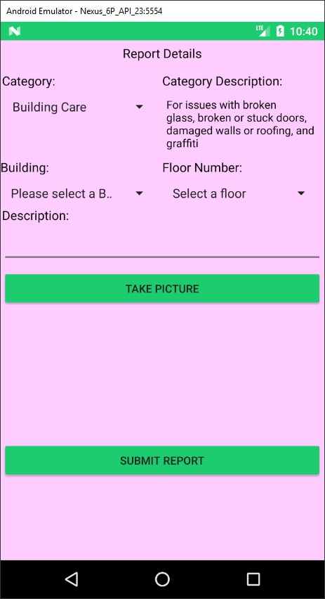
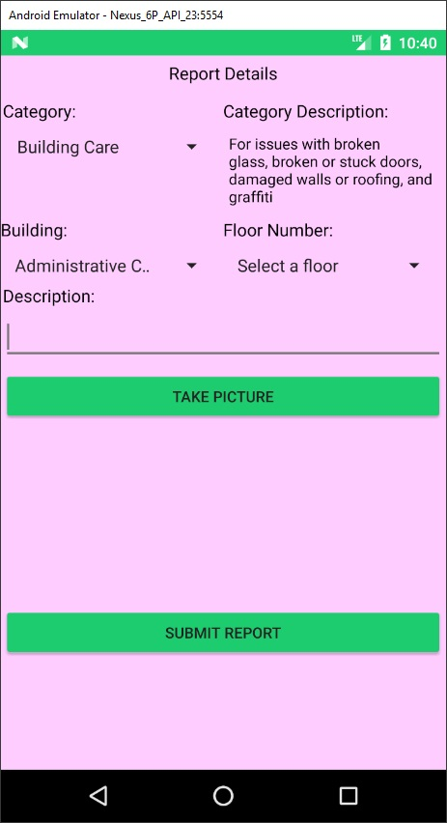
Application

Slide 12
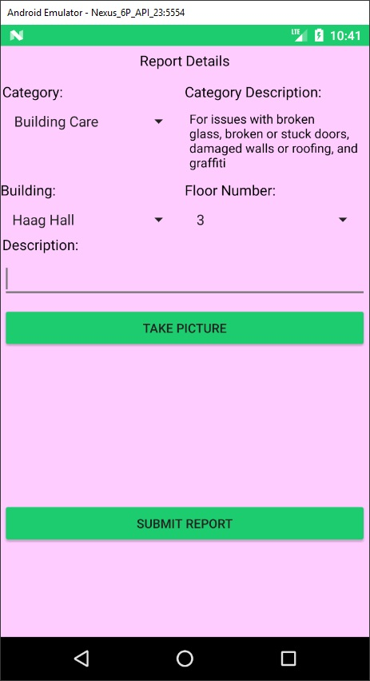
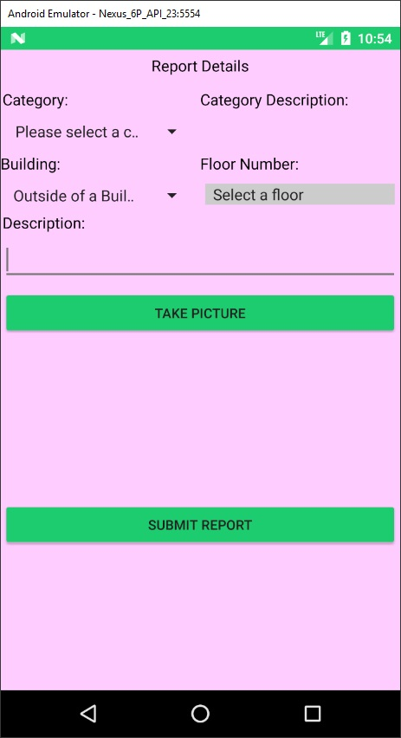
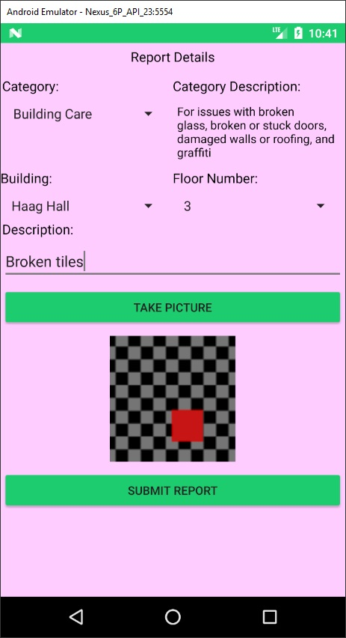
Application

Slide 13
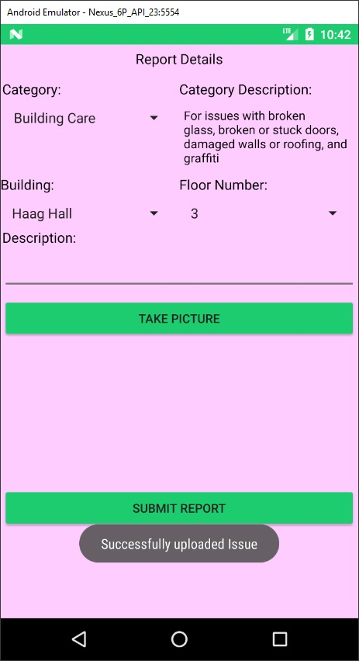
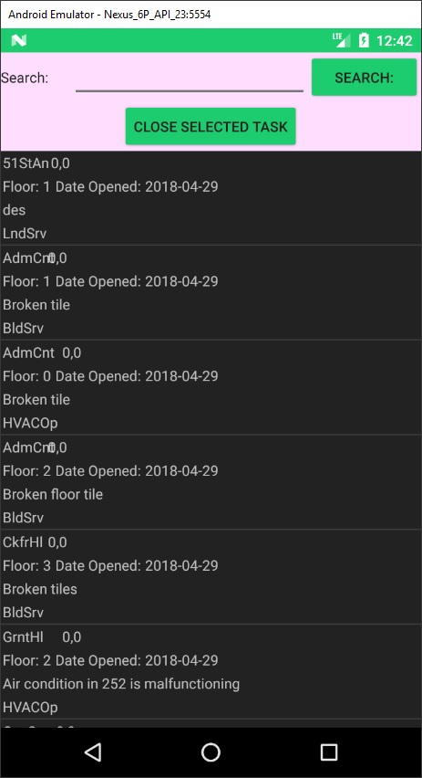
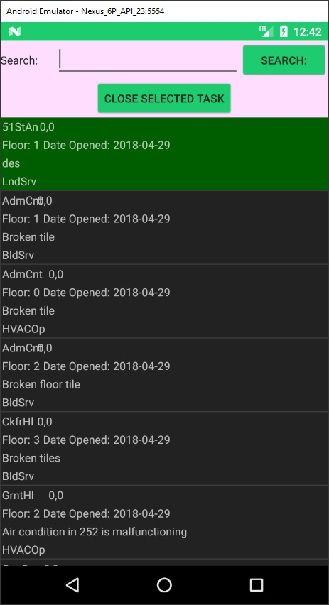
Application

Slide 14
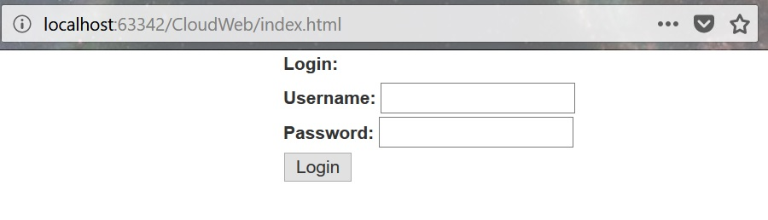
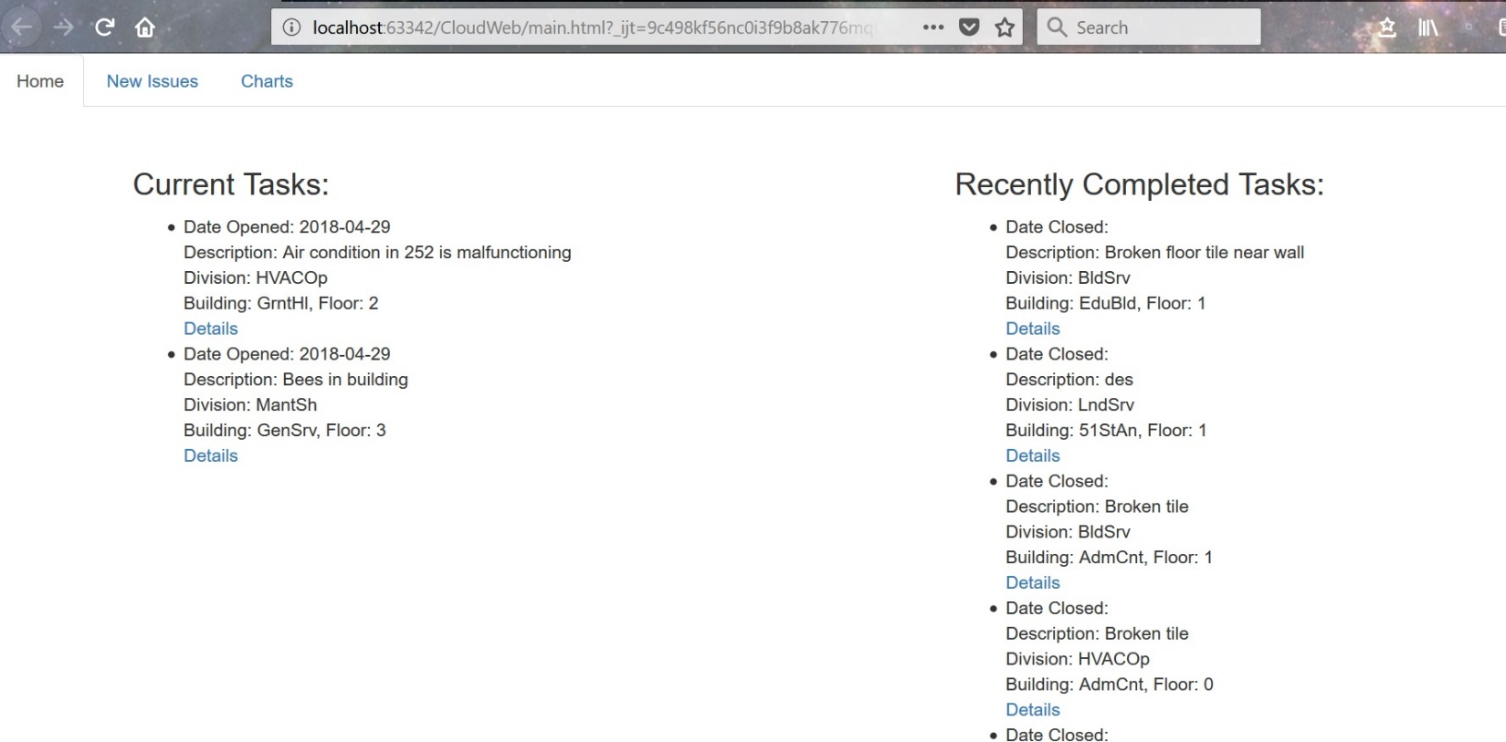
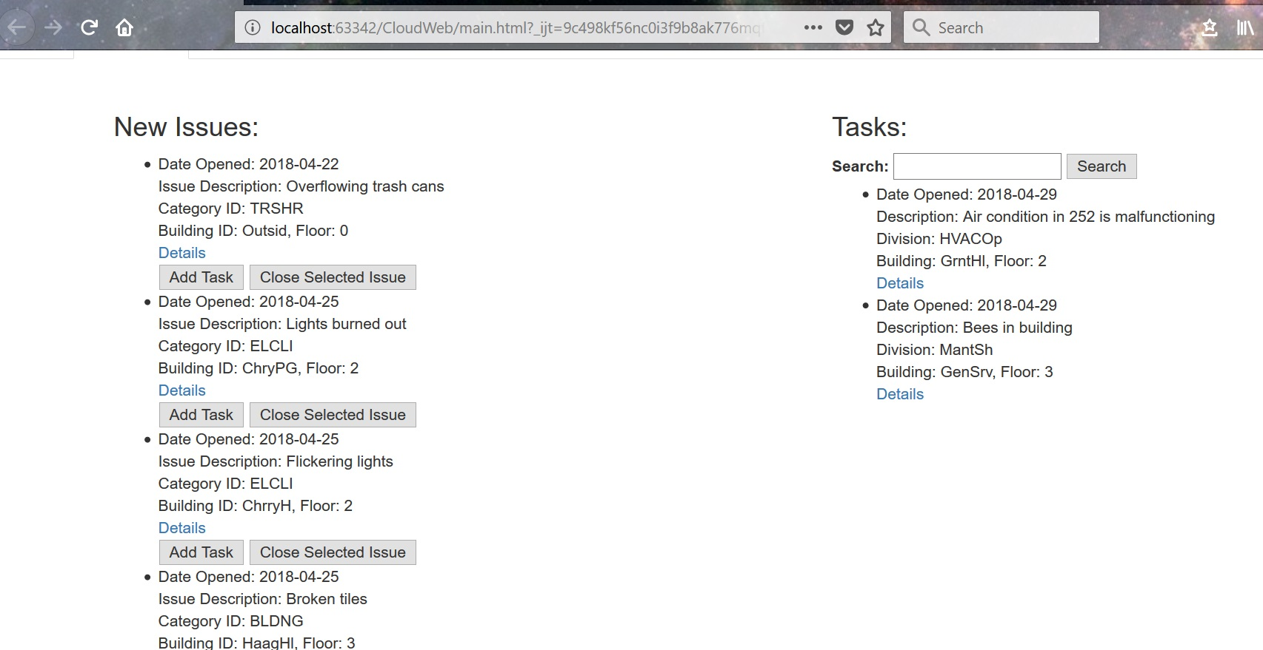
Application

Slide 15
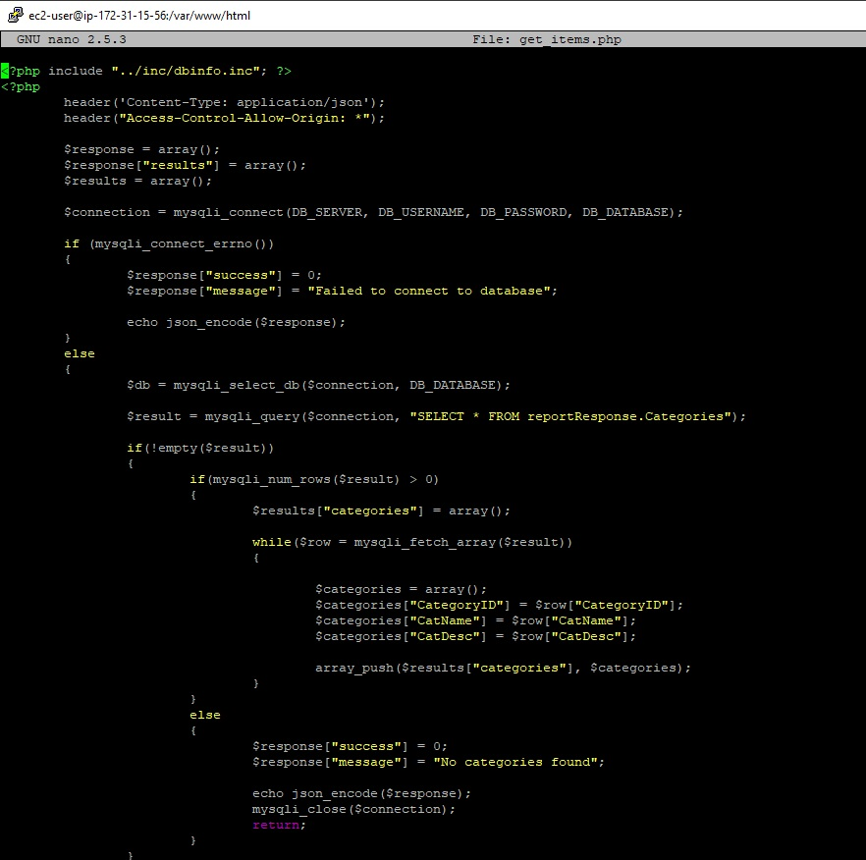
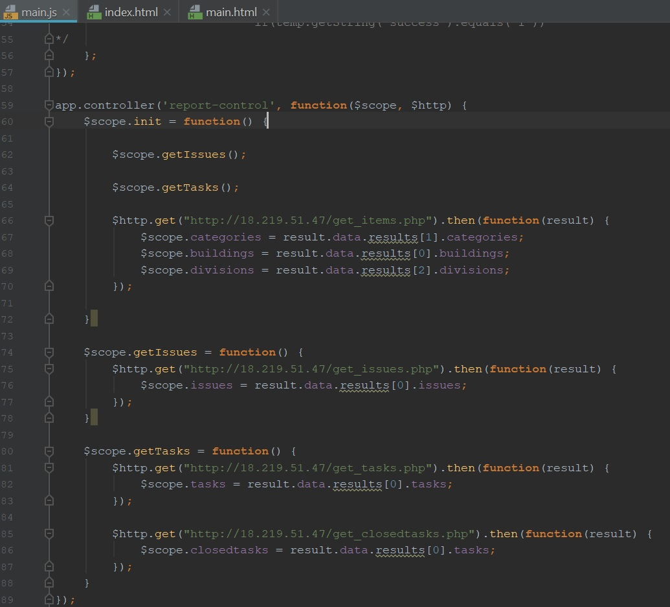
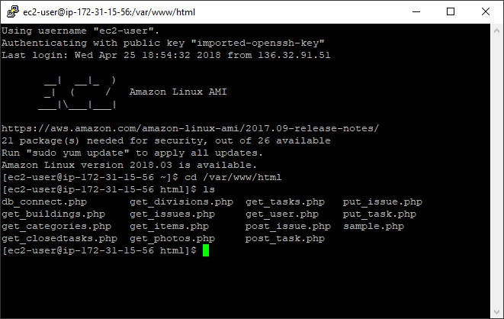
Application

